Slide 1

Robotics
Lecture themes

Slide 2
Contents
What is a robot?
Applications of Robots
Humanoid robot
Robot programming basics
  The Finch Robot
  Programming with Webots

Slide 3
What are robots?
A robot is a computer programmable machine capable of carrying out a complex series of actions automatically.
Robots can be guided by an external or embedded within control device. Wikipedia
According to ieee.org a robot is an autonomous machine capable of:
  sensing its environment, carrying out computations to make decisions, and performing actions in the real world.

Slide 4
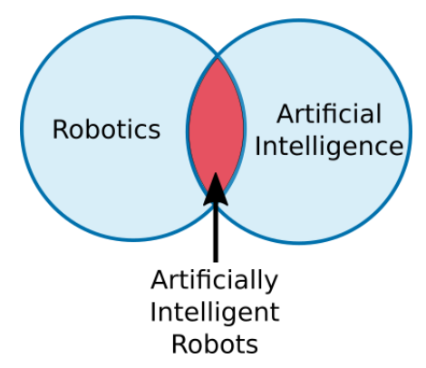
What are robotics?
Robotics is a branch of technology that deals with physical robots.
  The robots can carry out a series of actions autonomously, or semi-autonomously.
Most robots are not artificially intelligent- so artificially intelligent robots bridge robotics and AI programs.

Slide 5
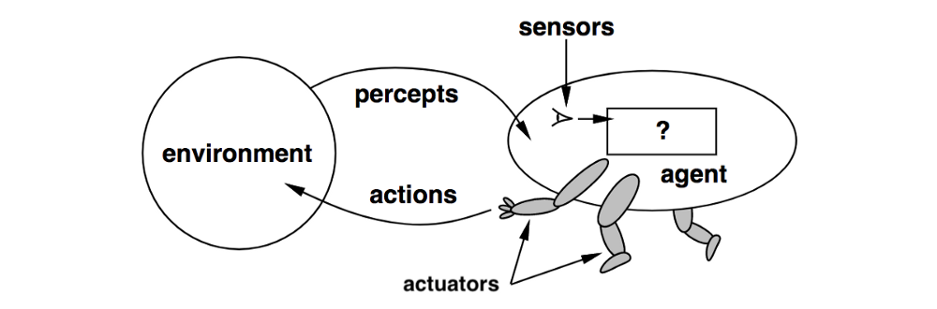
What are robotics?

Slide 6
Applications of Robots
In automotive industry
  Collaborative Robots
  Robotic Painting
  Robotic Welding
  Robotic Assembly
  Material Removal
  Part Transfer and Machine Tending

Slide 7
Applications of Robots …
Little robots on the farm
Home robots
  Cleaning
  Entertainment
  Domestic security

Slide 8
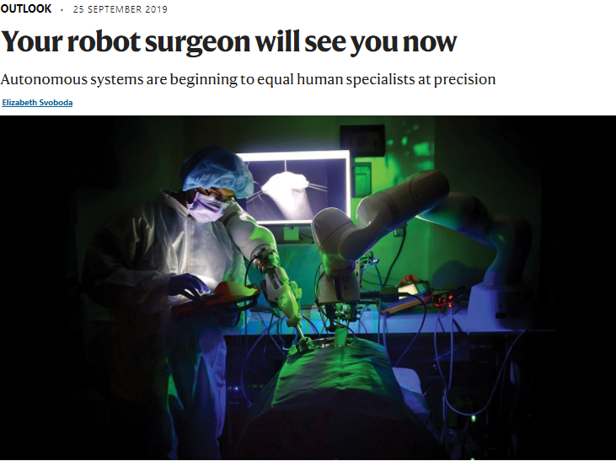
Applications of Robots …
Surgical applications

Slide 9
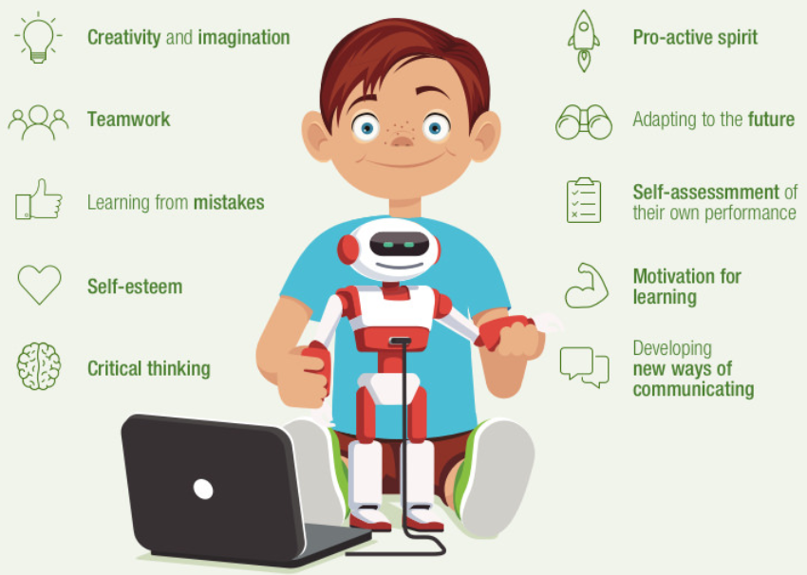
Applications of Robots …
Educational applications

Slide 10
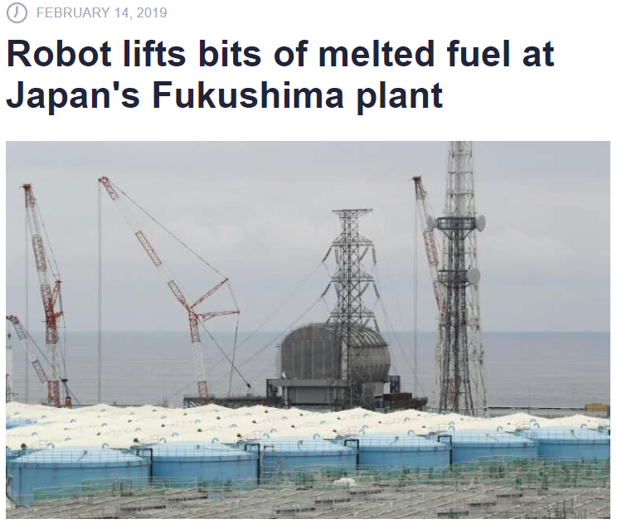
Applications of Robots …
A robot arm picked up pebble-sized pieces of radioactive fuel …

Slide 11
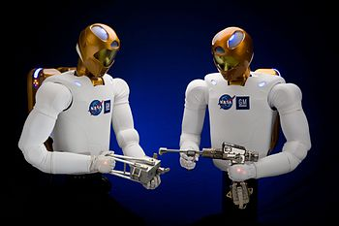
Humanoid robot
This is a robot having body shape like the human body.
Designed for- interacting with tools and environments, experiments in bipedal locomotion, etc.
Robonaut (more dexterity) and other applications

Slide 12
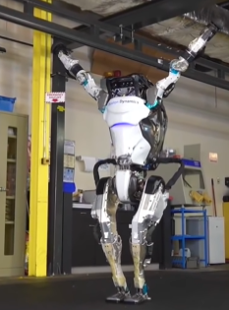
Humanoid robot ..
Boston Dynamics' amazing robots

Slide 13
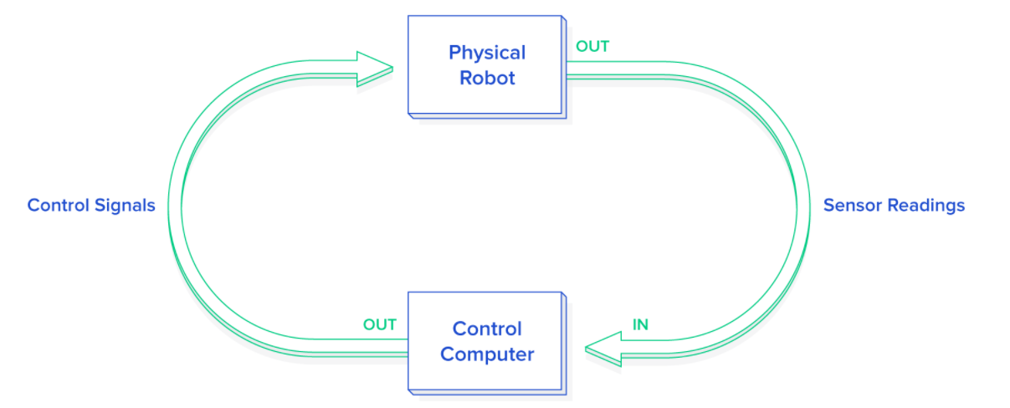
Robot programming basics
Robot control software
  languages like C (C++) and Python are often used together.
  C (C++) for used in control loops, image processing and hardware interface.
  Python- for high-level behaviors and quick proof of concepts.

Slide 14
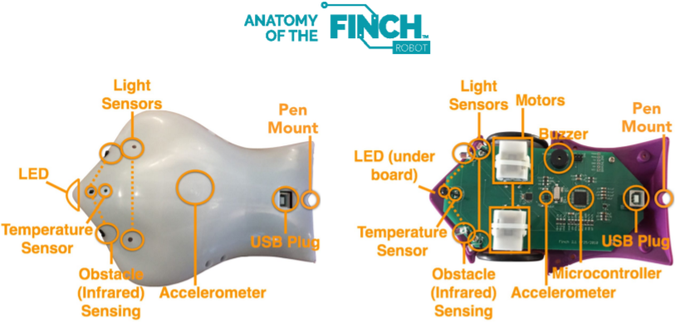
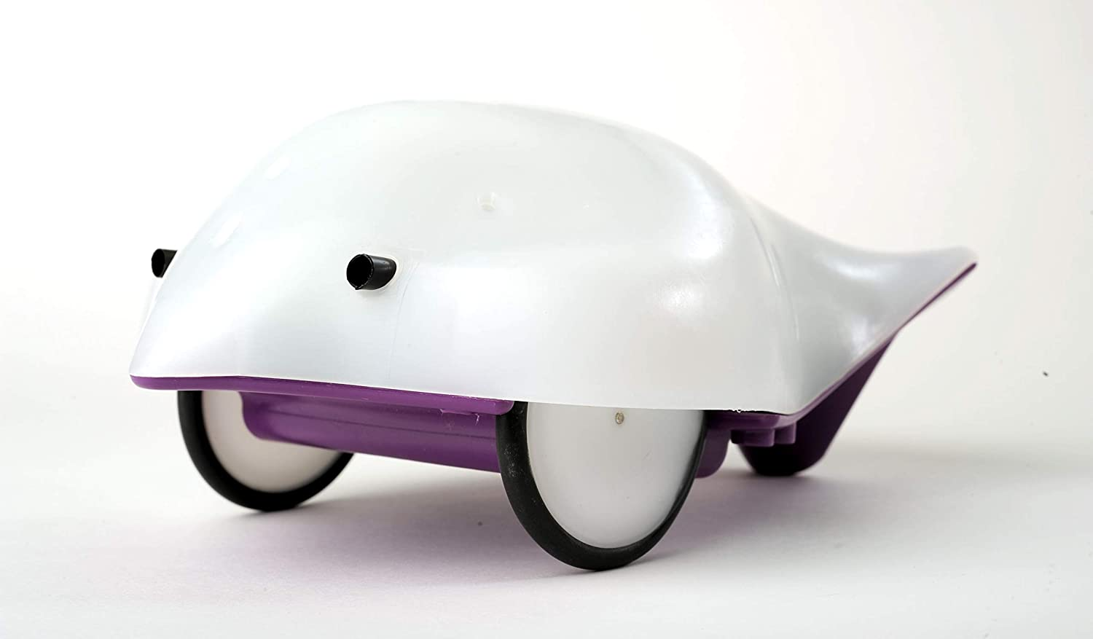
Robot programming basics …
The finch robot and software

Slide 15
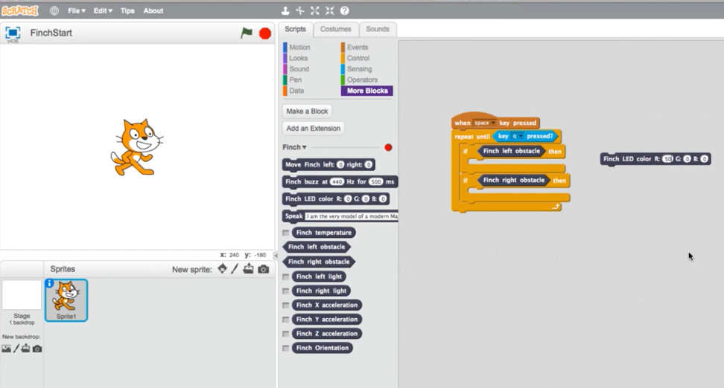
Robot programming basics …
Programming finch with scratch and outputs- see this guide

Slide 16
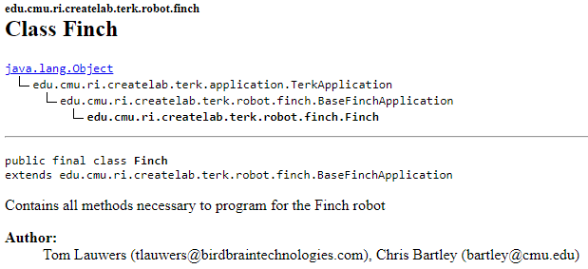
Robot programming basics …
Finch programming APIs in Java

Slide 17
Robot programming basics …
More on Finch robots
Creating shapes with Finch- demo 1 and demo 2
Finch following a light signal

Slide 18
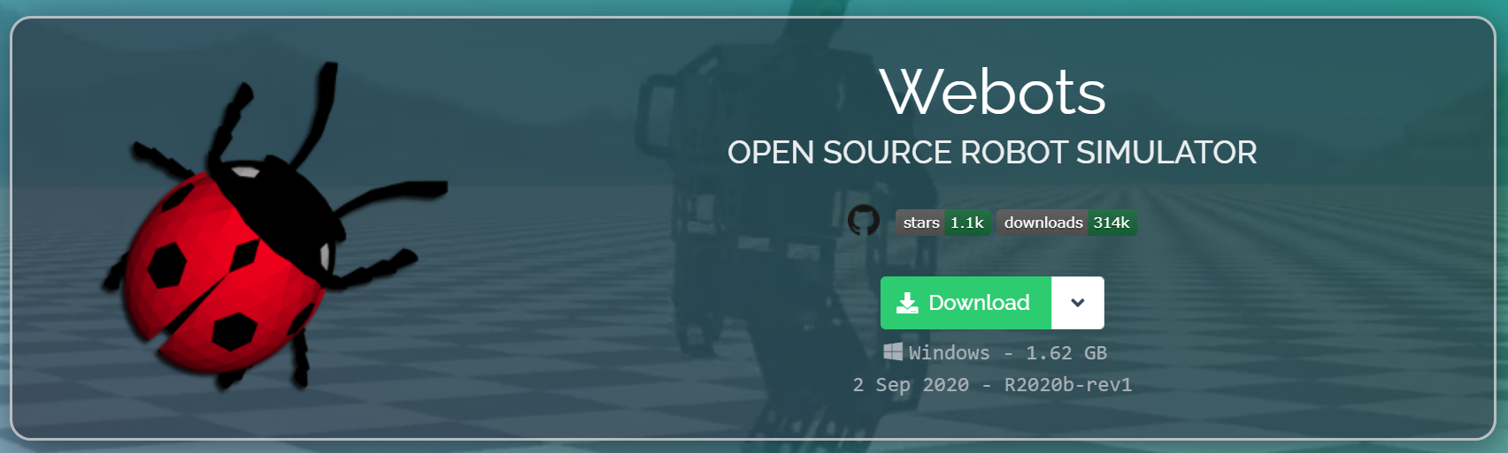
Robot programming basics …
Programming with simulator- Webots

Slide 19
Robot programming basics …
A tutorial on Webots
  Start Webots
  Create a New World
  Add an e-puck Robot
  Create a New Controller
  Extend the Controller to Speed Control

Slide 20
Points for discussion (1)
What is a robot?
What is intelligent robot?
Modern washing machine could be considered as a robot. – True, False
Which of the following is not a characteristic of robots? -multifunctionality, programmability, Efficiency, Responsibility
Physical structure of robots which moves around is called: - end-effector, link, joint, manipulator
Scara robot is more suitable for: - single operation, assembly operation, rotary operation, translatory operation
Notes:
end effector- is the device at the end of a robotic arm, designed to interact with the environment
The links are the rigid members connecting the joints. The joints (also called axes) are the movable components of the robot that cause relative motion between adjacent links.
Robot manipulators are created from a sequence of link and joint combinations. The links are the rigid members connecting the joints, or axes. The axes are the movable components of the robotic manipulator that cause relative motion between adjoining links.
SCARA Robots are a popular option for small robotic assembly applications. SCARA is an acronym for Selective Compliance Articulated Robot Arm, meaning it is compliant in the X-Y axis, and rigid in the Z-axis. The SCARA configuration is unique and designed to handle a variety of material handling operations.

Slide 21
Points for discussion (2)
(In group) discuss an activity that you think could be automated by using a robot.
  Define the tasks that the robot will perform.
  What kind of special tooling is required? Sketch if you will use any.
  Can the activity be justified economically? Show your development – do not simply say yes or no.
(In group) Watch frames 0:00 to 0:50 the video at Boston Dynamics' amazing robots – and reflect on the level of intelligence observed.
Follow the Webots user guide and repeat to develop the robot simulation.

Slide 22
Next themes
Moving to Manufacture
Ethics

